Slide 1
Making Smoother Transitions to Higher Education
December 6, 2016
Brittany Valdez
Notes:
Talking Points
UCEDDs were created in 1963 by the federal government with the enactment of Public Law 88-164 to serve people with intellectual disabilities.
Today, there are sixty-seven (67) Centers across the country, authorized under the Developmental Disabilities Assistance and Bill of Rights Act of 2000 (PL-106-402), to serve as resources for Americans with a wide range of disabilities.
The sixty-seven (67) Centers, at least one in every state and territory is affiliated with a major research University and serves as a resource for people of all ages.
The West Virginia Center is a unit within West Virginia University (WVU), Health Sciences, and because of the placement within the University, has access and alignment with the Schools of Pharmacy, Public Health, Nursing, Medicine and Dentistry. Reporting authority with WVU tacitly supports the opportunity for collaboration, education and training needed to support and strengthen the state’s capacity to meet the needs of persons with disabilities.
CEDs role is to provide education and training to University students in multiple disciplines; educate direct care providers who serve persons with disabilities; and provide policy makers with objective information about the status of disabilities services in West Virginia.
West Virginia's Center also provides gap filling direct services and supports in an effort to improve availability and acceptability of services.
On average, over the past five years, the national network of UCEDDs
Provided professional preparation for working in the disability field to over 2,000 students annually.
Provided technical assistance and training each year to over one million health, education, mental health, and policy-making professionals, as well as people with disabilities and their families.
Provided direct (clinical or other) services to more than 700,000 individuals with developmental disabilities and/or their families annually.
Conducted nearly 3,000 research projects each year whose results may benefit people with disabilities.
Developed and disseminated over 7,000 different publications annually to bring the most current information to professionals and the community.
Federal appropriations for Centers are not intended to support all facets of operations.
There is an expectation that federal resources will be leveraged to secure additional monies from state and local agencies, to address issues specific to each state.
West Virginia's Center for Excellence in Disabilities in partnership with the Developmental Disabilities Council (DDC) and the State Protection and Advocacy agency, West Virginia Advocates, is engaged in capacity building, advocacy and system change that promote the integration and inclusion of people with disabilities in community life.

Slide 2
A part of West Virginia University & WVU Health Sciences Center
Center for Excellence in Disabilities
Notes:
Key Talking Points: Recommendation is to start out explaining that your program is a part of CED, then lead into program information and training topic
-CED is a unit within West Virginia University (WVU), Health Sciences, and because of the placement within the University, has access and alignment within the Schools of Pharmacy, Public Health, Nursing, Medicine and Dentistry.

Slide 3
West Virginia Assistive Technology System (WVATS)
Dedicated to increasing awareness of and access to assistive technology for West Virginians of all ages and types of disabilities
Federally funded; each state has an assistive technology project

Slide 4
Higher Ed Statistics
According to the National Center for Education Statistics, 20.5 million students enrolled in institutions of higher education in Fall 2016.
11.1% of students enrolled in institutions of higher education have some type of a disability (National Center for Education Statistics).

Slide 5
Americans with Disabilities Act (ADA)
Title II prohibits the discrimination of people with disabilities in institutions of higher education regardless of whether or not the institution receives federal funding.
Public institutions
Private institutions

Slide 6
Section 504 of the Rehabilitation Act
Prohibits the discrimination of students with disabilities by any college receiving any type of federal funding.
Includes religious colleges that receive federal funding

Slide 7
Section 504 of the Rehabilitation Act
Institutions of higher education must provide students with disabilities with the “auxiliary aids and services”, such as assistive technology, that they need to fully participate in the learning experience (28 C.F.R. §§ 35.160(a), (b); 36.303).
Includes making reasonable accommodations and modifications to the institutions’ policies, practices, and procedures (28 C.F.R. § 35.104)

Slide 8
Students with disabilities report resistance from faculty and staff members in obtaining the reasonable accommodations.
Can make the transition to higher education extremely difficult and stressful for students
Two-thirds of students with disabilities do not receive the services that they need (Inside Higher Ed).

Slide 9
Reasonable Accommodations
Modifications in policies and practices based on the individual student's needs.
Examples:
Not deducting for spelling errors on exams and papers
Allowing extra time for exams
Additional time to complete degree requirements
Transportation
Distraction-free spaces for exam taking
Allowing service animals in classrooms
Providing written outlines or summaries of class lectures
(Sources: Disability Rights California; Pacer Center)
Notes:
Modifications of policies and practices are not required when it would fundamentally alter the nature of the service, program, or activity.
Accommodations may affect how a test is taken, but not what it measures.

Slide 10
Auxiliary Aids and Services
Examples:
Interpreters for students with hearing impairments
Use of electronic note takers and tape recorders
Alternative formats (large print, Braille, electronic) for students with visual impairments
(Sources: Disability Rights California; Pacer Center)

Slide 11
Assistive Technology
Assistive Technology can be any device or service used to perform tasks that would otherwise be difficult or impossible to do.

Slide 12
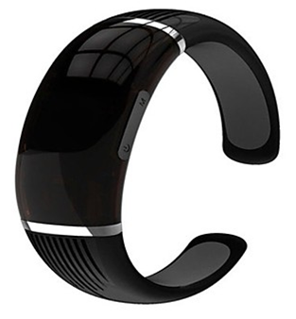
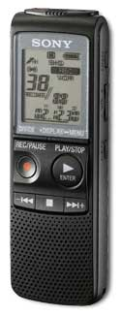
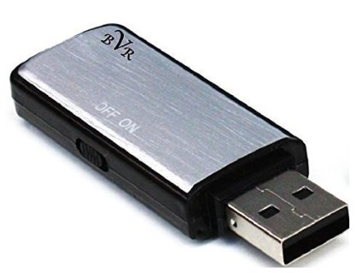
Recording Devices
WR-18 High Fidelity
Digital Spy Voice Portable Recorder
Sony ICD PX720
Center for Excellence in Disabilities
Notes:
This is a fantastic entry level recorder, especially considering it has USB connectivity - allowing transfer of files to a pc.

Slide 13
Note Takers
Livescribe Echo Smartpen
Neo Smartpen N2
Center for Excellence in Disabilities
Notes:
Neo smartpen N2: Our favorite smartpen is the Neo smartpen N2, the first gadget in this category to really feel like a pen—it’s a little bigger and heavier than an ordinary pen, but not so large that it feels strange in your hand. As you write or doodle, it automatically syncs to your mobile device via Bluetooth, using its own Neo Notes app (for iPhone and Android). Evernote users will especially like this one because it can automatically sync notes, which will keep your paper notes and your digital notes all organized in one place.
The N2 does require special paper for the pen to know what you’re marking, and Neo sells it in a variety of sizes and formats (plain, lined, and grid). Prices range from $14.90 (for 5 notebooks) to $29.80 (for 10 notebooks), which adds up but if you’re not keen on the cost you can print your own paper using Neo’s N Toaster app—though it currently only works for Windows.

Slide 14
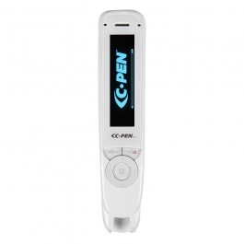
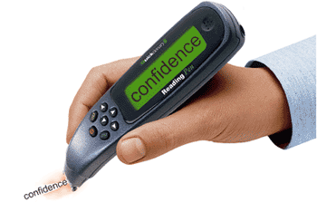
Reading Pens
Reading Pen 2
C-Pen
Center for Excellence in Disabilities

Slide 15
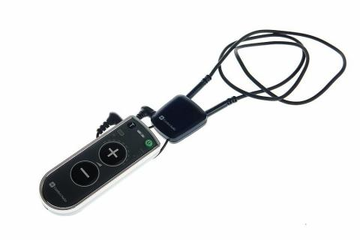
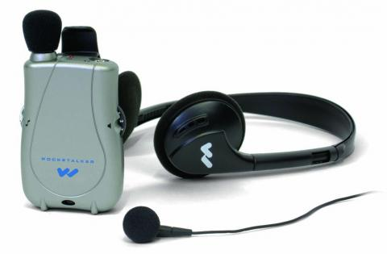
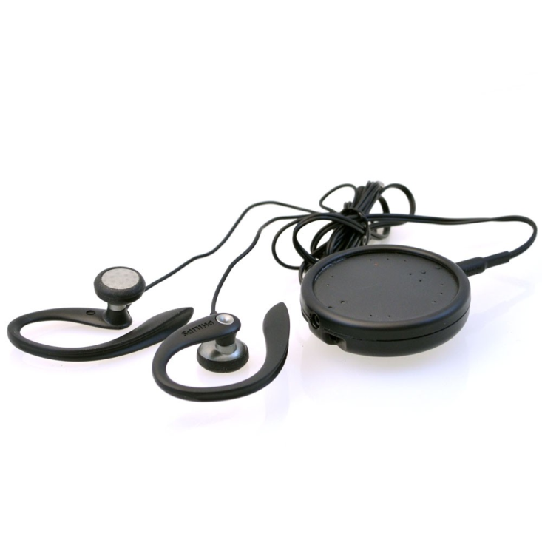
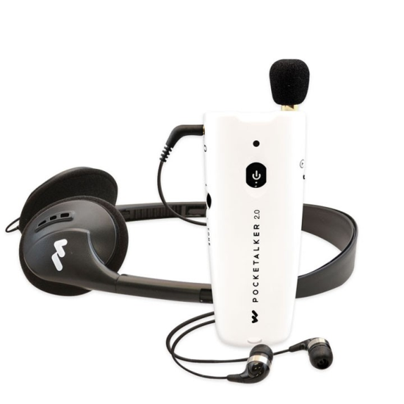
Personal Listening Devices
Comfort Duett with Neckloop
Pocketalker Ultra
ActiVocal Wear Personal Amplifier
Williams Sound Pocketalker 2.0
Center for Excellence in Disabilities

Slide 16
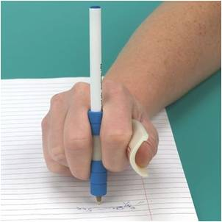
Writing Aids
ErgoWriter
Pencil Grips
Ring-Pen Writing Instrument
Arthwriter Hand Aid
Center for Excellence in Disabilities

Slide 17
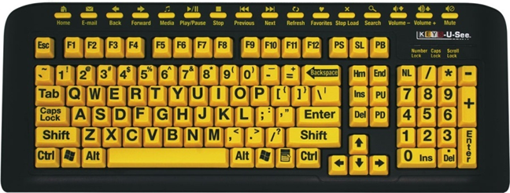
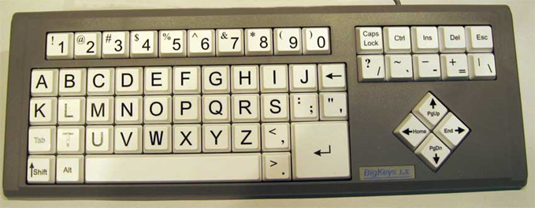
Alternative Keyboards
Keys-U-See Keyboard
Big Keys ABC Keyboard
Center for Excellence in Disabilities
Notes:
Color Vision Deficiency
Colorino can identify more than 150 colors, announcing them in a clear voice. It is available in 20 different languages, including English and Spanish. Its light probe function can detect sources of light and differentiate between natural and artificial sources. It can be connected to other electronic devices. Other features include a hole for inserting a ribbon to carry the device around the neck. The unit comes with a carrying case, and instructions in large print, braille, and audiocassette. It costs about $200.

Slide 18
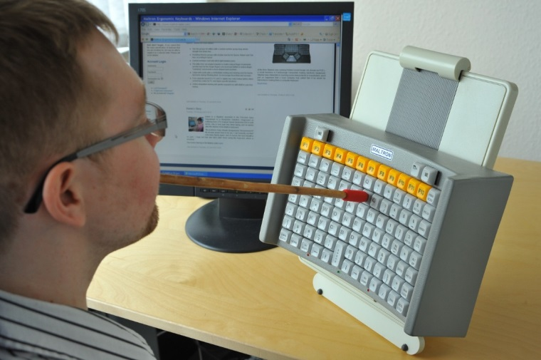
Alternative Keyboards
MALTRON Head/Mouth
Stick Keyboard
MALTRON One Handed Keyboard
Center for Excellence in Disabilities

Slide 19
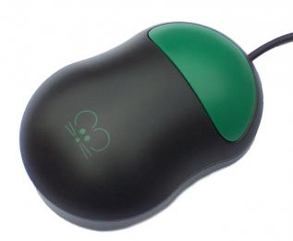
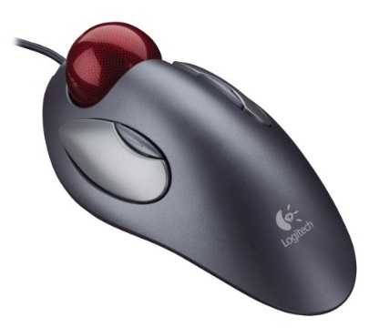
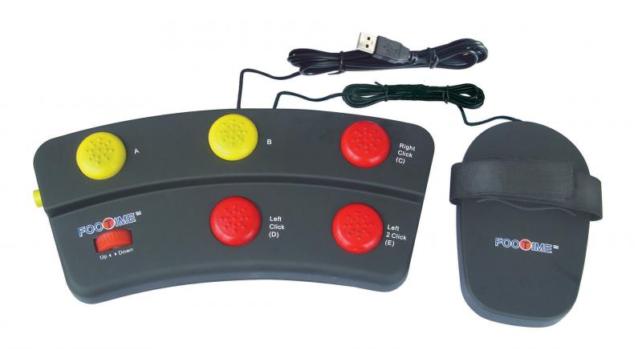
Alternative Mice
Chester One
Button Mouse
Logitech Trackball Mouse
Finger Trackball Mouse
Footime Mouse
Center for Excellence in Disabilities

Slide 20
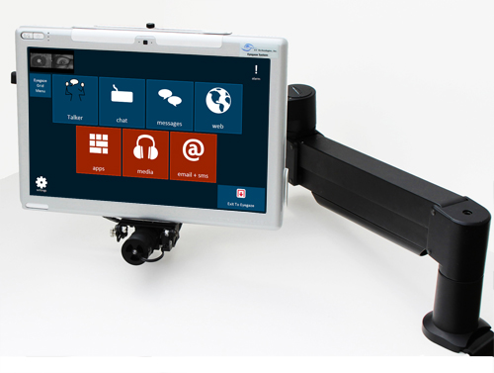
Head and Eye Tracking Devices
Naturalpoint Smartnav Head Tracking Mouse
Eyegaze Edge
Tracking System
Center for Excellence in Disabilities

Slide 21
Screen Reading Software
Read back text on the screen
Highlight text on the screen as the program “speaks” the information
Allows user to choose between different voices or accents
Center for Excellence in Disabilities

Slide 22
Voice Recognition Software
Dragon Naturally Speaking
Built-in Voice Recognition Software
Center for Excellence in Disabilities
Notes:
Voice recognition is becoming increasingly popular and readily available. Some newer computers have speech recognition built into the operating system. For those who need a more advanced option, speech recognition software might be a better fit than what their computer offers as a built-in accessibility feature.
Speech recognition allows the user to access the computer by using their voice. It can be very useful for those with motor impairments and /or learning disabilities.

Slide 23
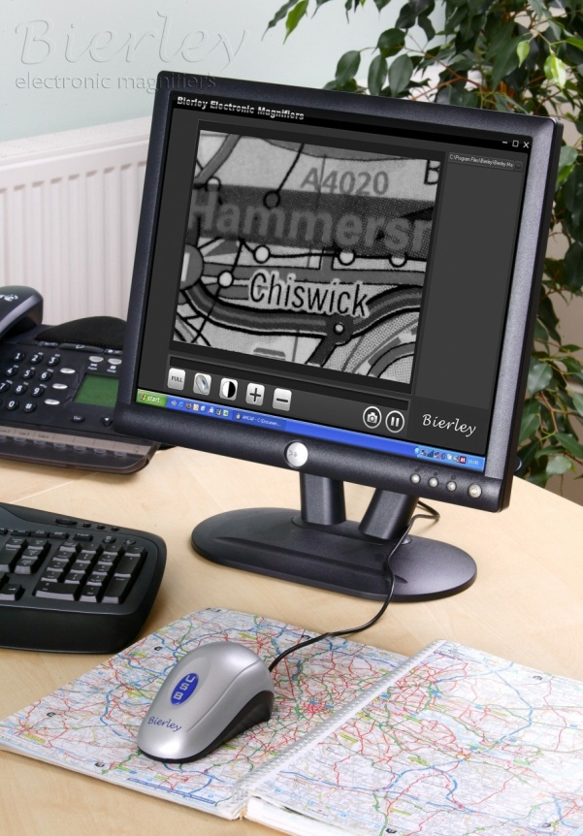
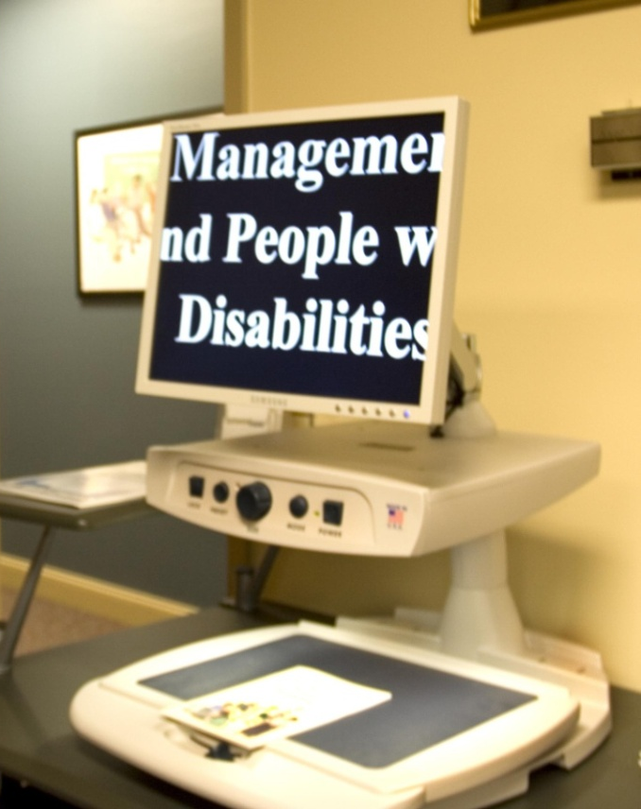
Magnification Devices
Bierley USB
Magnifier
Merlin CCTV
Center for Excellence in Disabilities

Slide 24
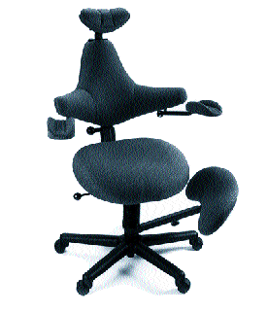
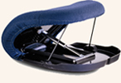
Adjustable Seats
Uplift Cushion
Ergonomic Chair
Center for Excellence in Disabilities

Slide 25
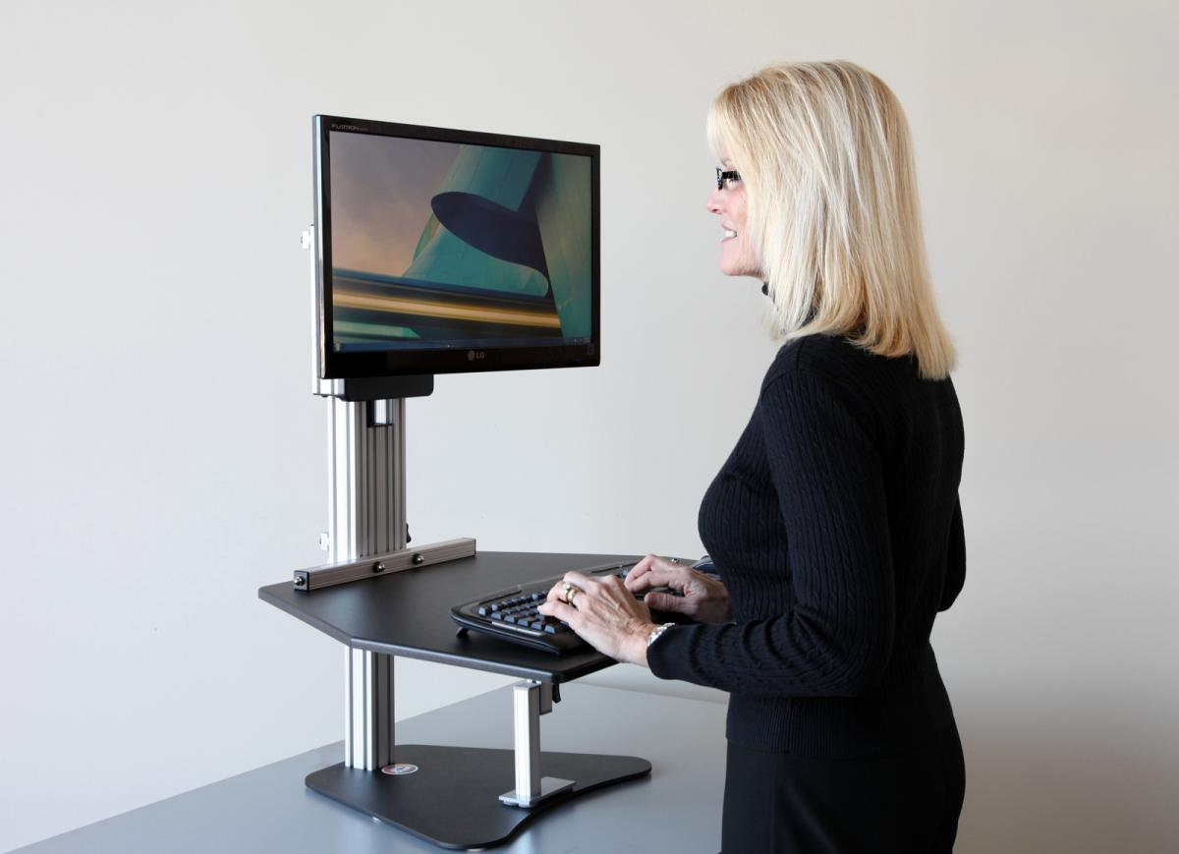
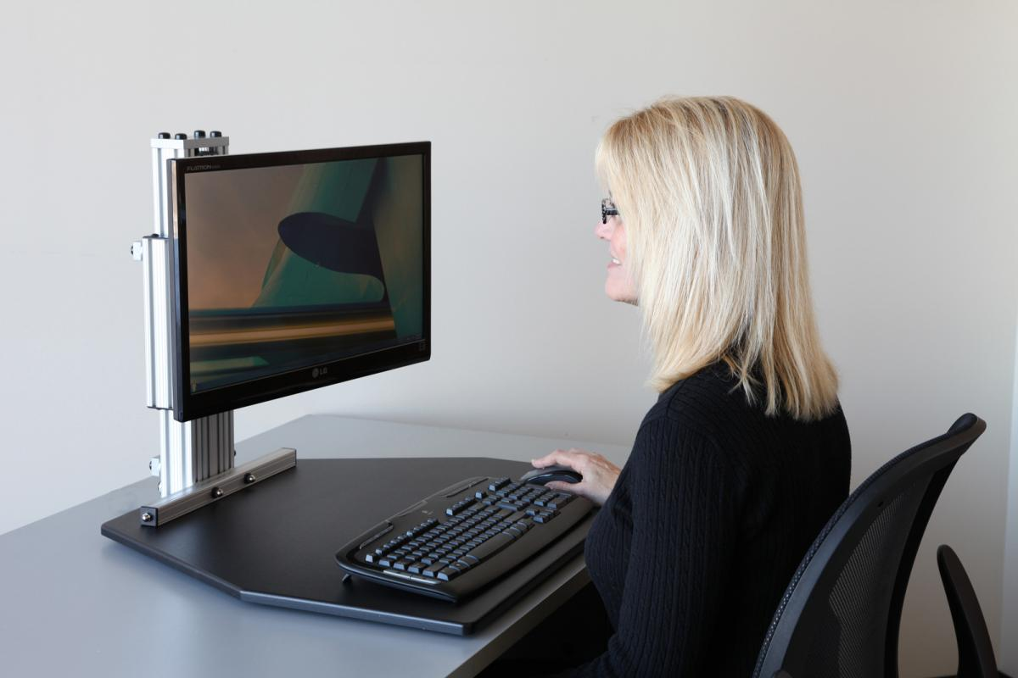
Adjustable Height Work Surfaces
Kangaroo Height Adjustable Work Surface
Center for Excellence in Disabilities

Slide 26
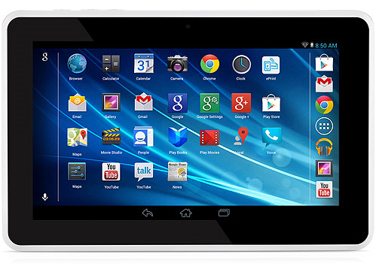
Tablets
Text-to-Speech
Speech-to-Text
Magnification
Invert Colors
Closed Captions
Switch Access
Center for Excellence in Disabilities

Slide 27
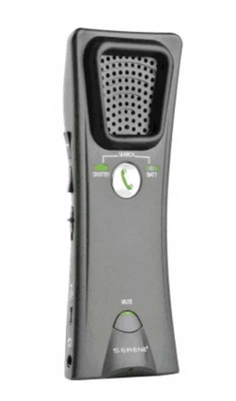
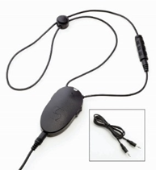
AT for Tablets
Serene Innovations HearAll Amplifier
ClearSounds Amplified Neckloop
Center for Excellence in Disabilities

Slide 28
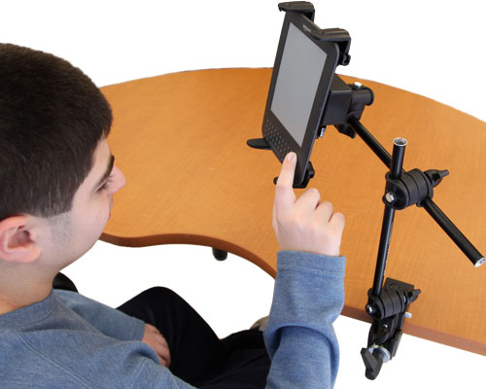
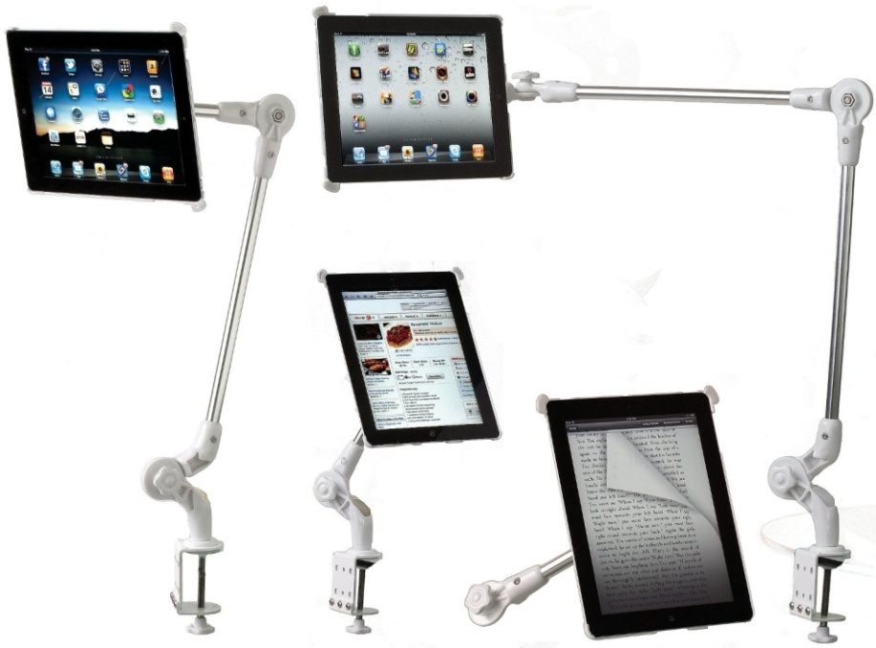
AT for Tablets
Tablet Holder with Mount
Armbot Tablet Mount
Center for Excellence in Disabilities

Slide 29
Assistive Apps
Sign4Me
Live Caption
Magnifying Glass
Voice Recorder (Apple)
Audio Recorder (Android)
AnyList
Center for Excellence in Disabilities
Notes:
Magnifying Glass with Light

Slide 30
West Virginia Assistive Technology System (WVATS) 959 Hartman Run Road Morgantown, WV 26505 800-841-8436 304-293-4692 wvats@hsc.wvu.edu http://wvats.cedwvu.org
Center for Excellence in Disabilities
Notes:
Key Talking Points:
How to contact the program, Center, make a referral, etc.

